Slide 1
COMP 3400
Week 14 – Wednesday

Slide 2
Last time
What did we talk about last time?
Review up to Exam 1
System architectures
State machines
Processes
Kernel and system calls
fork()/exec()/wait()
Files
Signals
IPC
Pipes
FIFOs
Memory mapping files
Message queues
Semaphores

Slide 3
Questions?

Slide 4
Assignment 8

Slide 5
Review

Slide 6
Final exam format
Final exam will be in this room:
Wednesday, April 30, 2025
8:00 – 10:00 a.m.
50% longer than previous exams, but you have 100% more time
Mostly short answer questions
One or two matching questions
A couple of debugging questions
A couple of programming questions

Slide 7
Networking

Slide 8
Networking
IPC can be extended to processes working on different machines
The goal is still to do more complex computation than would be possible or convenient with a single process
However, communicating between processes on different machines is much less reliable
This unreliability is particularly strong on the Internet
Servers can crash
Network outages can cause machines to be unreachable
General chaos means that everything can be working reasonably well and yet messages are sometimes lost

Slide 9
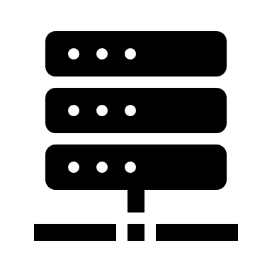
Visualization
Home Network
Business Network
Backbone Router
Backbone Router
Backbone Router
Local ISP Router
Local ISP Router

Slide 10
Layer models
Networking always involves layers
Each layer talks to the one above and below it and can often be swapped out for different protocols that provide similar services
For this class, we'll be talking about a five layer Internet model
Simpler than the 7 layer OSI model
Remember that the purpose of models is to understand complex systems
Different people use different names for the same layers
 | Application
OS | Transport
 | Internet
Hardware | Link
 | Physical
Application
Transport
Internet
Link
Physical
Internet
Link
Physical
Internet
Link
Physical

Slide 11
Layers
Application layer
Logical endpoints of communication
Actual processes that are talking to each other
Example protocols: HTTP, FTP, SSH
Transport layer
Implemented as sockets, the software endpoints of communication
Provides message passing system calls
Breaks down messages into fixed-size segments
Demultiplexes: Takes all messages arriving at the machine and sends them to appropriate processes by port number
Example protocols: TCP and UDP

Slide 12
Layers continued
Internet layer
Provides point-to-point communication between hosts and routers
Uses addresses to determine the logical location of hosts
Determines the route that packets will travel along
Link layer
Sends packets between devices on the same network
Closely tied to hardware
Example protocols: Ethernet, WiFi, Bluetooth
Physical layer
Actual hardware
Interprets electrons or radio waves as bits

Slide 13
Packets
Every system of computer networking we'll talk about uses packets
A packet is chunk of data with header information like ports and addresses
Each layer encapsulates the data from the layer above it for transmission
The application data is usually bigger than the headers, but we don't draw it to scale
When being technical, each layer calls its packets different things:
Transport layer: segments
Internet layer: packets
Link layer: frames
Datagram is also used as a synonym for packet
Be aware that all these terms get thrown around
Link Layer Frame
Internet Layer Packet
Transport Layer Segment
Link
Header
Internet Header
Transport Header
Application Data

Slide 14
Naming and addressing
Local IPC used a name that often mapped to a path in the file system
Networked IPC usually needs more information:
Host to connect to
Sometimes port
File or resource being requested
A standard form for this information is a uniform resource identifier (URI):
Note that brackets mark optional entities
URI = scheme:[//authority]path[?query][#fragment]

Slide 15
Sockets

Slide 16
Sockets
The most basic element of the networking arsenal is the socket
A socket is half of a tw0-way connection between hosts
We create a socket with a call to socket()
Returns an int, essentially a file descriptor
Is similar to calling open() on a file
We can call read() and write() on socket file descriptors
int socket (int domain, int type, int protocol);

Slide 17
IPv4
Old-style IP addresses are often written in this form:
74.125.67.100
4 numbers between 0 and 255, separated by dots
That's a total of 256⁴ = 4,294,967,296 addresses
But there are 8 billion people on earth…

Slide 18
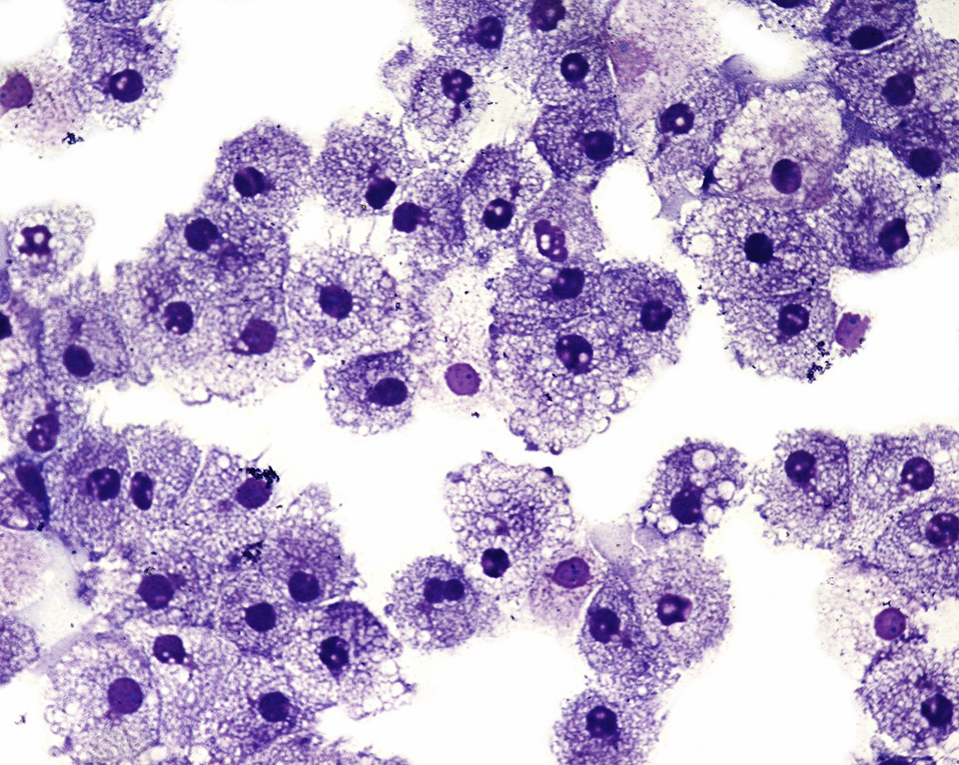
IPv6
IPv6 are the new IP addresses that are beginning to be used by modern hardware
Often written as 8 groups of 4 hexadecimal digits each
2001:0db8:85a3:0000:0000:8a2e:0370:7334
1 hexadecimal digit has 16 possibilities
How many different addresses is this?
16³² = 2¹²⁸ ≈ 3.4×10³⁸ is enough to have 500 trillion addresses for every cell of every person’s body on Earth

Slide 19
Details for socket()
int socket (int domain, int type, int protocol);
domain
What the socket will be used for
Typical values are IPv4, IPv6, or local communication
type
Determines the transport layer
Usually TCP or UDP for this class
protocol
Usually not used and set to 0
Can be used for special raw sockets used for packer sniffers
Field | Constant | Purpose
domain | AF_INET | IPv4 addresses
 | AF_INET6 | IPv6 addresses
 | AF_LOCAL | Unix domain socket for IPC
 | AF_NETLINK | Netlink socket for kernel messages
 | AF_PACKET | Raw socket type
type | SOCK_STREAM | Byte-stream communication, for TCP transport
 | SOCK_DGRAM | Fixed-size messages, for UDP transport
 | SOCK_RAW | Raw data that is not processed by transport layer
protocol | IPPROTO_RAW | IP datagrams without transport-layer processing
 | ETH_P_ALL | Ethernet frames without network-layer processing

Slide 20
Networking data structures
Different data structures are needed to specify addresses depending on what kind of networking is being done
Since C doesn't have inheritance, structs with the same size are treated interchangeably and then cast to each other when appropriate
One of these is struct sockaddr, which is 16 bytes in size
// generic address structure
struct sockaddr {
sa_family_t sa_family; // two bytes: AF_INET, etc.
char sa_data[14];
};

Slide 21
IPv4 socket addresses
The structure for holding IPv4 addresses is identical in size to struct sockaddr
// IPv4 address structure
struct sockaddr_in {
sa_family_t sin_family;
in_port_t sin_port;
struct in_addr sin_addr;
char sin_zero[8];
};
struct in_addr {
in_addr_t s_addr; // in_addr_t is an alias for uint32_t
};
Type | struct sockaddr
Fields | sa_family |  | sa_data
Data | 02 | 00 | 00 | 50 | 5d | b8 | d8 | 22 | 00 | 00 | 00 | 00 | 00 | 00 | 00 | 00
Fields | sin_family |  | sin_port |  | sin_addr |  |  |  | sin_zero
Type | struct sockaddr_in

Slide 22
IPv6 socket addresses
IPv6 addresses are longer and consequently require bigger (and stranger looking) structs
// IPv6 address structure
struct sockaddr_in6 {
sa_family_t sin6_family;
in_port_t sin6_port;
uint32_t sin6_flowinfo;
struct in6_addr sin6_addr; // IPv6 addresses are 128-bit
uint32_t sin6_scope_id;
};
struct in6_addr {
union {
uint8_t __u6_addr8[16]; // aliased as s6_addr
uint16_t __u6_addr16[8]; // aliased as s6_addr16
uint32_t __u6_addr32[4]; // aliased as s6_addr32
} __u6_addr;
};

Slide 23
Endian conversion
Rather than try to keep straight what the endianness of our machine and the endianness of the network is, we use a family of functions:
hton: host to network endianness
ntoh: network to host endianness
They come in l (long) versions (for 32-bit integers) or s (short) versions (for 16-bit integers)
uint32_t htonl (uint32_t hostlong); // 32-bit from host to network
uint16_t htons (uint16_t hostshort); // 16-bit from host to network
uint32_t ntohl (uint32_t netlong); // 32-bit from network to host
uint16_t ntohs (uint16_t netshort); // 16-bit from network to host

Slide 24
Getting addresses from a host name
DNS converts a host name to an IP address
The getaddrinfo() function lets us get a linked list of matching addresses
The only annoying bit is that we have to fill out a hints structure
A utility function freeaddrinfo() is provided to free the linked list structure when done with it
int getaddrinfo (const char *name, const char *service,
const struct addrinfo *hints, struct addrinfo **results)
void freeaddrinfo (struct addrinfo *info);

Slide 25
The addrinfo struct
The result of getaddrinfo() is stored into the pointer given by the last argument
struct addrinfo {
int ai_flags;
int ai_family;
int ai_socktype;
int ai_protocol;
socklen_t ai_addrlen;
char *ai_canonname;
struct sockaddr *ai_addr; // Pointer to address we need
struct addrinfo *ai_next; // Pointer to next addrinfo in linked list
};

Slide 26
Client side: connecting
After all the madness is done getting the sockaddr, a client can connect to a listening server with the connect() function
The connect() function is a blocking call that will eventually succeed or fail to connect the socket file descriptor to an actual network connection
If successful, we can read and write from that file descriptor
int connect (int socket, const struct sockaddr *address, socklen_t address_len);

Slide 27
Server side: options
The server side is more complicated
It's useful to set some options on the socket using the (confusing) setsockopt() function
Reusing the port, allowing reuse of the same port, even after crashing
Timing out on read messages
After creating the socket:
int setsockopt (int socket, int level, int option, const void *value, socklen_t lengeth);
//Allow port reuse
int on = 1;
setsockopt (socketfd, SOL_SOCKET, SO_REUSEADDR, (const void *) &on, sizeof (int));
// Set a 5-second timeout when waiting to receive
struct timeval timeout = { 5, 0 };
setsockopt (socketfd, SOL_SOCKET, SO_RCVTIMEO, (const void *) &timeout,
sizeof (timeout));

Slide 28
Server side: binding and listening
After creating the server socket (and maybe setting options), the next step is to bind the server to a port
For UDP, the server is then ready to receive messages
For TCP, it has to listen on the socket
The backlog gives how many clients can queue up when trying to connect to the server
int bind (int socket, const struct sockaddr *address, socklen_t address_len);
int listen (int socket, int backlog);

Slide 29
Server side: accepting
For TCP connections, after listening, the server can call accept()
Blocking function
Will wait until a client tries to connect
Then, messages can be sent and received
Doing so sets up a TCP session, expecting a series of packets from the connecting client
int accept (int socket, struct sockaddr *address, socklen_t *address_len);

Slide 30
TCP
Communication
Server
Client
socket()
socket()
bind()
listen()
accept()
connect()
read()
write()
Repeat until done
write()
read()
close()
close()

Slide 31
UDP
Communication
Server
Client
socket()
socket()
bind()
connect()
recvfrom()
sendto()
Repeat until done
sendto()
recvfrom()
close()
close()

Slide 32
TCP Socket Programming

Slide 33
TCP communication
The biggest differences between single-machine and networked IPC:
Networked IPC typically employs protocols so that machines agree on how data should be formatted
Networked IPC is less reliable
It's hard to talk about TCP communication without examples that use some particular application layer protocol
We're going to use HTTP because:
It's easy to understand
It's really important
There are lots of servers in the world we can talk to without any credentials

Slide 34
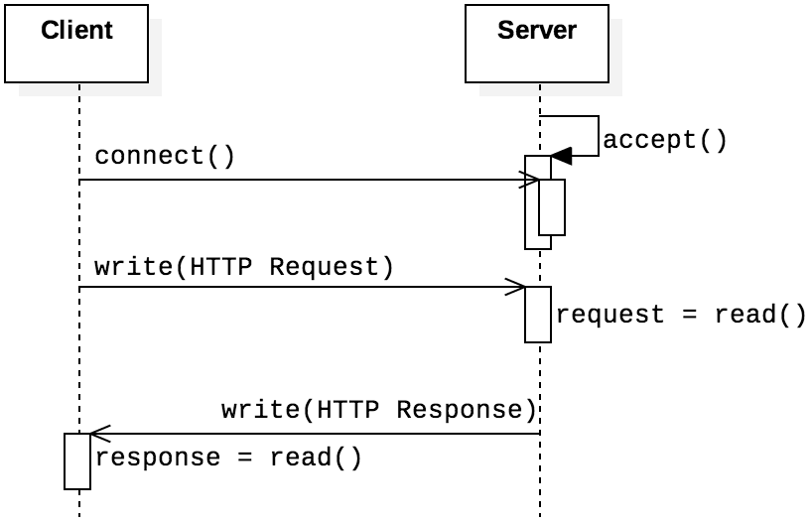
HTTP
Hypertext Transfer Protocol (HTTP) is the protocol for (non-encrypted) web page communication
It's a request-response protocol
Shown in the sequence diagram on the right
HTTP itself is stateless: no information is preserved between requests
Other features built around HTTP (cookies, server-side scripting, and databases) overcome this stateless limitation

Slide 35
Sample request
HTTP requests and responses start with header lines
Each ends with CRLF (\r\n), with an extra CRLF after all headers
Each \r\n would simply look like a newline, but we show them below for clarity
The most common client request is GET
It must have a line like the following:
path is the file being requested
version is the HTTP version, usually 1.0, 1.1, or 2
GET /path HTTP/version\r\n
GET /index.html HTTP/1.0\r\n
Accept: text/html\r\n
Accept-Encoding: gzip, deflate, br\r\n
Accept-Language: en-US,en;q=0.5\r\n
User-Agent: Mozilla/5.0\r\n
\r\n

Slide 36
Sample response
After sending that data, the response will look something like the following:
HTTP/1.1 200 OK\r\n
Content-Type: text/html; charset=UTF-8\r\n
Date: Sun, 28 Feb 2021 22:20:28 GMT\r\n
Content-Length: 1256\r\n
Connection: close\r\n
\r\n
<!doctype html>\n
<html>\n
<head>\n
<title>Example Domain</title>\n
</head>\n
<body>\n
<div>\n
<h1>Example Domain</h1>\n
<p>This domain is for use in illustrative examples in documents.</p>\n
</div>\n
</body>\n
</html>\n

Slide 37
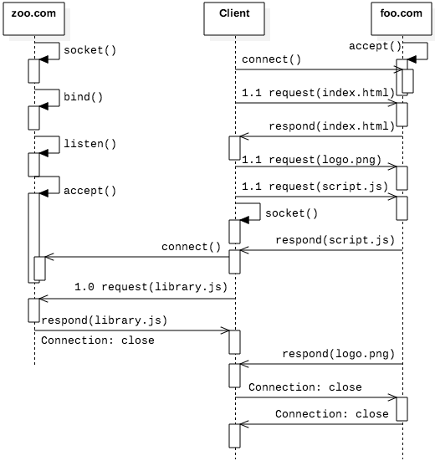
Persistent connections
HTTP/1.0 was one and done
HTTP/1.1 allows for persistent connections, so that multiple requests can be made over the same TCP connection
HTML that requires multiple requests is below
The sequence diagram showing the communication is on the right
<html>
<head>
<script src="http://zoo.com/library.js" />
<script src="script.js" />
</head>
<body><img src="logo.png" /></body>
</html>

Slide 38
Processing headers
After reading headers we can look through each one
One critical thing is to find the length of the content, so we can allocate enough space for it
char *line = buffer;
char *eol = strstr (line, "\r\n");
size_t body_length = 0;
while (eol != NULL) // While there are more CRLFs
{
eol[0] = '\0'; // Null-terminate each line
printf ("HEADER LINE: %s\n", line);
// Find content length
if (! strncmp (line, "Content-Length: ", 16))
{
char *len = strchr (line, ' ') + 1;
content_length = strtol (len, NULL, 10);
}
line = eol + 2; // Move to the next line
eol = strstr (line, "\r\n");
}

Slide 39
Getting the content
On the previous slide, we found the length of the content
It's possible that the content was so small we read it into our 8 KB buffer
Otherwise, we'll need to allocate more space
int length = strlen(eoh + 4);
char *content = malloc(length + 1);
strcpy(content, eoh + 4);
if (content_length > length) // if false, all data received
{
// Increase the content size and read additional data
// Bytes needed is the Content-Length minus bytes already received
content = realloc (content, content_length);
bytes = read (socketfd, content + length, content_length - length);
}

Slide 40
UDP Socket Programming

Slide 41
UDP socket programming
As with TCP, it's hard to give meaningful examples of code without using some application-level protocol
For TCP, we did HTTP
For UDP, we'll do DNS
DNS, the Domain Name System, is the distributed network of servers that translates domain names into IP addresses

Slide 42
DNS
ICANN maintains the root structure of DNS
Below the root are top level domains (TLDs) like com, edu, org, net and a lot of weird newish ones like engineering and pink
Different companies manage each TLD
Domains can be looked up from the TLD that houses it
edu knows where otterbein.edu can be found
Dots separate each entity
It’s a kind of little endian ordering where the leftmost entity is the most specific, growing more general to the right
DNS is case insensitive
.
edu
com
org
otterbein
mit
microsoft
amazon
code

Slide 43
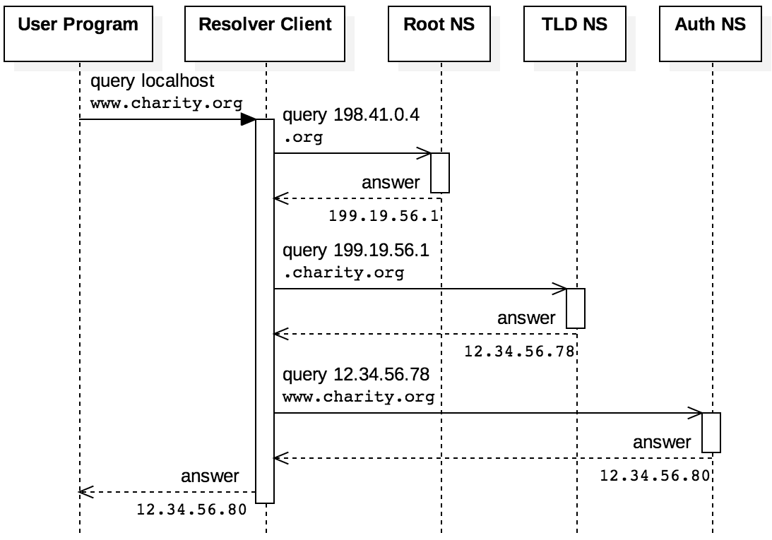
DNS queries
Queries can be iterative:
Ask the root, get a response for the TLD
Ask the TLD for the domain you want
Get a response closer to what you're looking for and repeat
Shown on the right
Queries can also be recursive:
Ask a name server, it handles everything
To make the system efficient, servers cache domains that have been asked for recently
There's a time-to-live value that says how long a cached domain should be kept

Slide 44
DNS resource record structure
DNS information is sent in resource records, which have the following form:
NAME is the human-readable domain name
TYPE is gives the kind of record
A is an IP address
CNAME is a canonical name
NS is an authoritative name server
CLASS is what protocol, often IN for Internet
TTL is time-to-live in a cache
RDLENGTH is the length of the data in the record
RDATA is the data
NAME and RDATA are variable length, and all other fields are 16 bits
NAME
TYPE
CLASS
TTL
RDLENGTH
RDATA

Slide 45
DNS requests
Like HTTP, DNS is a request-response protocol
Unlike HTTP, DNS uses UDP and messages aren't as human readable
DNS messages contain five fields: header, question, answer, authority, and additional
Headers start with a random ID to keep messages straight
Example request to resolve example.com:
Field | Data in Hex | Meaning
Header | 1234 | XID=0x1234
 | 0100 | OPCODE=SQUERY
 | 0001 0000 0000 0000 | 1 question field
Question | 0765 7861 6d70 6c65 0363 6f6d 00 | QNAME=EXAMPLE.COM
 | 0001 0001 | QCLASS=IN, QTYPE=A
Answer
Authority
Additional
Note:
Instead of dots, QNAME gives the number of characters for each name part
Character | 7 | e | x | a | m | p | l | e | 3 | c | o | m | 0
Hex | 07 | 65 | 78 | 61 | 6d | 70 | 6c | 65 | 03 | 63 | 6f | 6d | 00

Slide 46
DNS responses
Here's a reasonable response to the request from the previous slide
Don't worry about the OPCODE, it's a set of bits laid out according to DNS rules
QNAME uses a special code to indicate that the name is 12 bytes into this response (to avoid repetition)
Field | Data in Hex | Meaning
Header | 1234 | XID=0x1234
 | 8180 | OPCODE=SQUERY, RESPONSE, RA
 | 0001 0001 0000 0000 | 1 question and 1 answer
Question | 0765 7861 6d70 6c65 0363 6f6d 00 | QNAME=EXAMPLE.COM
 | 0001 0001 | QCLASS=IN, QTYPE=A
Answer | c00c | QNAME=EXAMPLE.COM [compressed]
 | 0001 | QTYPE=A
 | 0001 | QCLASS=IN
 | 0000 e949 | TTL = 0xe949 = 59721
 | 04 | RDLENGTH = 4
 | 0x5db8d822 [93.184.216.34] | RDATA
Authority
Additional

Slide 47
Broadcasting

Slide 48
Static and dynamic IP addresses
Networked devices are configured to have either a static or dynamic IP address
Static IP addresses are set in a configuration file and rarely change
Dynamic IP addresses are assigned when a device connects to a network
Most of the devices you own have dynamic IP addresses
Your laptop or phone is dynamically assigned an IP address by your router when you connect, either on WiFi or Ethernet
Even your router is dynamically assigned an IP address by your ISP
Servers usually have static IP addresses so that DNS records don't need constant updates

Slide 49
DHCP
But if you've just connected your device to the network, how does it get its IP address?
Dynamic Host Configuration Protocol (DHCP) is a protocol for getting a dynamic IP address
The socket programming we've been talking about requires an IP address for a client
That's where messages are sent back to
So how do you receive a message if you don't have an IP address…because you're trying to get an IP address?
Broadcasting!

Slide 50
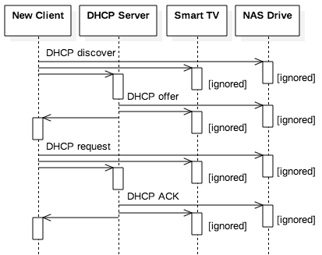
Broadcasting
Instead of sending a message point to point, DHCP messages are broadcast via UDP on port 67
The destination is the special IP address 255.255.255.255 reserved for broadcasting
The source is the special IP address 0.0.0.0 indicating no valid IP
A DHCP server receives messages and responds with an IP address
Other devices ignore the messages

Slide 51
DHCP steps
DHCP is more complex than HTTP or DNS since it's got multiple steps
The new device broadcasts a DHCP discover message asking for an IP
The DHCP server broadcasts a DHCP offer message offering an IP
The new device broadcasts a DHCP request message asking to take the IP it was offered
The DHCP server broadcasts a DHCP ACK message acknowledging that the device has been assigned the address in question
Like DNS, the device uses a random xid to keep different requests straight
When the device requests the IP it's been offered, it increments the xid by 1

Slide 52
DHCP example
The table shows an example of the addresses and messages broadcast to request and assign an IP address
yiaddr is the new IP address
siaddr is the server IP address
The lease time is how long the IP address is valid for, in seconds: 86,400 = 24 hours
When the lease expires, the device can ask for the IP again
Message type | UDP addressing | DHCP contents
DHCP discover | SRC: 0.0.0.0:68 DEST: 255.255.255.255:67 | op: BOOTREQUEST xid: 42 yiaddr: 0.0.0.0
DHCP offer | SRC: 192.168.1.1:67 DEST: 255.255.255.255:68 | op: BOOTREPLY xid: 42 yiaddr: 192.168.1.7 siaddr: 192.168.1.1 lease time: 86400
DHCP request | SRC: 0.0.0.0:68 DEST: 255.255.255.255:67 | op: BOOTREQUEST xid: 43 yiaddr: 192.168.1.7 siaddr: 192.168.1.1
DHCP ACK | SRC: 192.168.1.1:67 DEST: 255.255.255.255:68 | op: BOOTREPLY xid: 43 yiaddr: 192.168.1.7 siaddr: 192.168.1.1 lease time: 86400

Slide 53
Application Layer

Slide 54
Peer-to-peer applications
We have already given examples of client-server applications
HTTP
DNS
Although some client-server interactions are much more complicated, many of the same principles will apply
Peer-to-peer applications (P2P) are the other major, application-layer approach
Every host is potentially a client and a server
Communicating with peers is more complex because there isn't a single server to keep track of
In many situations, P2P applications can provide better performance than client-server when the number of hosts is large

Slide 55
P2P examples
P2P has a historic association with illegal file sharing, but P2P architectures are used for many different kinds of applications
Application | Service Description | Examples
Content Distribution | Scalable approaches to sharing data across the Internet | File storage and sharing: Gnutella, BitTorrent, InterPlanetary File System (IPFS) Content delivery networks (CDNs): Akamai, Limelight Streaming media: Spotify (originally), Sonos Software update distribution: Linux, World of Warcraft
Distributed Computing | Delegating work for an application across many computers | Privacy and censorship resistance: Tor, Freenet Cryptocurrency: Bitcoin Botnets and malware: Storm
Collaboration | Providing real-time human communication | Voice Over IP (VOIP): Skype (originally) Instant Messaging: Tox
Platforms | Building applications | Java: JXTA (obsolete)

Slide 56
Content delivery networks
Normally, there's a single server for a webpage
What if that webpage has content that millions of people from all over the country want to view?
The load on the server will be huge
Getting the webpage will be slow, or the server could crash
Content delivery networks (CDNs) provide caches of webpages
People trying to view a webpage will be redirected to a physically close mirror
Big companies like Google, Amazon, and Netflix have their own CDN services
Less well-known companies like Akamai provide CDN services to others
Image from Wikipedia

Slide 57
Overlay networks
Dashed lines show the overlay network
P2P hosts are fundamentally connected by the Internet
However, they view their connections inside the P2P network as an overlay network, connections to other P2P hosts
Thus, socket connections are made to P2P neighbors who forward messages on to other neighbors
A
C
D
Router
Router
B
Router
Router
Router
Router
G
E
F

Slide 58
Overlay networks
Dashed lines show the overlay network
For A to send a message to B, it has to send it to C, which sends it to E which sends it to B
Even though A and B are on the same network!
While this arrangement seems inefficient, it can be used in applications like Tor, where the goal is to hide the true addresses of the hosts
A
C
D
Router
Router
B
Router
Router
Router
Router
G
E
F

Slide 59
Characteristics of P2P networks
Design decision: Should a P2P network be structured or unstructured?
Early P2P networks were often unstructured
This approach made sense for illegal file sharing
Unstructured networks have a lot of churn, hosts arriving and leaving frequently
Many P2P networks are now structured with a logical framework
Maybe the overlay network arranges nodes in a circle, with each node knowing about the node before it and after it
A CDN might have an organization based on physical proximity

Slide 60
More characteristics of P2P networks
Design decision: How are objects like files identified in the network?
Unstructured networks often use query flooding
Ask all your neighbors if they have a file
If they don't have it, they'll ask their neighbors, and so on
Structured networks have more options
Indexing objects based on location
Local indexes only know about neighbors
Depending on the structure, algorithms can be used to search the network
Centralized indexes are simple but put strain on a central server
Other approaches distribute the index across several servers

Slide 61
Transport Layer

Slide 62
Transport layer
The transport layer provides a logical structure for end-to-end communication between two different (networked) processes
Although there are other protocols for the transport layer, the most common ones are flavors of UDP and TCP
As we have pointed out in the past:
TCP provides reliable transport that tries to fix failures
UDP is faster but unreliable

Slide 63
UDP
The User Datagram Protocol (UDP) provides a bare-bones approach to sending messages
Information included in a UDP segment is:
Source port
Destination port
Length of the segment
Checksum
Payload (actual data)
Each header field is 16 bits, making a header of 8 bytes for each UDP segment in addition to the data

Slide 64
Checksum
UDP uses a checksum to make sure that the segment isn't corrupted during transmission
It is possible (but unlikely) that a message with some bits flipped will have the same checksum as the original
Pseudo-code:
Add up all the 16-bit quantities in the message into a 32-bit sum
While adding, if the most significant bit of the sum is 1, change the sum to be the sum of its lower and upper halves
If there was an odd number of bytes, add the last byte padded with zeroes
After the sum is made, add the lower and upper halves of it to get a 16-bit value
Return the bitwise negation of the result

Slide 65
Example UDP segments
The following are UDP segments for a DNS request and response
Header | 1388 0035 0025 f693 | source port = 5000 (0x1388) destination port = 53 (0x0035) length = 37 (0x0025) checksum
Payload | 1234 0100 0001 0000 0000 0000 0765 7861 6d70 6d64 0363 6f6d 0000 0100 01 | DNS request for example.com
Header | 0035 1388 0035 af04 | source port = 53 (0x0035) destination port = 5000 (0x1388) length = 53 (0x0035) checksum
Payload | 1234 8180 0001 0001 0000 0000 0765 7861 6d70 6d64 0363 6f6d 0000 0100 01c0 0c00 0100 0100 00e9 4900 045d b8d8 22 | DNS response for example.com

Slide 66
Unreliability
Once the UDP segment arrives, the receiver can compute a checksum for the segment to see if it matches the one provided
UDP itself doesn't do anything with this checksum value, but the applications built on UDP can decide to request the data again or ignore the bad data
This lack of reliability seems like a problem, but it can be useful for streaming movies or audio
It's also useful for DNS and DHCP, which are not usually visible to the user

Slide 67
TCP
Reliable transport is often desirable, so Transmission Control Protocol (TCP) is usually used for that purpose
Unlike UDP, TCP creates a session with multiple messages sent back and forth between the two hosts
Messages are numbered
TCP also uses flow control, allowing hosts to avoid sending more data at once than their receivers can handle

Slide 68
TCP segments
Because they have to do more, TCP segments contain more information:
Source port
Destination port
Sequence number (SEQ)
Acknowledgement number (ACK)
Flags
Receive window
Checksum
Urgent data pointer
Optional fields
Payload (actual data)
Like UDP, most of these fields are 16 bits
SEQ and ACK are 32 bits
Optional fields vary
Payload is however long it needs to be

Slide 69
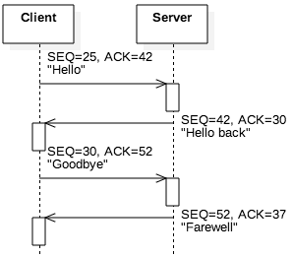
Numbering
So that segments aren't lost, hosts send a sequence number (SEQ) with each segment
The initial value is a random number k
After sending n bytes, the next SEQ will be n + k
So that the A knows how much B has gotten, B's next response to A contains an acknowledgement number (ACK) which is the last SEQ from A plus the size of that message
In this way, both sides know how much the other side is sending, what's lost, and what's received
If nothing is lost and messages are going back and forth, each SEQ will be the last ACK received

Slide 70
Flow control
Buffers are always finite
A TCP connection has a buffer that's reading information as it arrives from the other host
Data is removed from this buffer as the process reads it from the socket
If too much data is arriving, the buffer fills up, and data will be lost
Each time a process sends a TCP segment, it also sends a receive window value, giving the number of bytes available in the buffer for that connection
If there's not enough space for the next message, the sender will break its message into parts so that the part it sends will fit into the receive window

Slide 71
Example TCP segment
The following is a TCP segment for an HTTP GET request
Header | 1388 0050 0000 0017 0000 002a 5010 1000 cf33 0000 | source port = 5000 (0x1388) destination port = 80 (0x0050) sequence number = 23 (0x17) acknowledgement number = 42 (0x2a) flags receive window = 4096 (0x1000) checksum urgent data ptr
Payload | 4745 5420 2f20 4854 5450 2f31 2e31 0d0a 486f 7374 3a20 6578 616d 706c 652e 636f 6d0d 0a43 6f6e 6e65 6374 696f 6e3a 2063 6c6f 7365 0d0a 0d0a | GET / HTTP/1 .1\r\nHost: ex ample.com\r\nC onnection: c lose\r\n\r\n

Slide 72
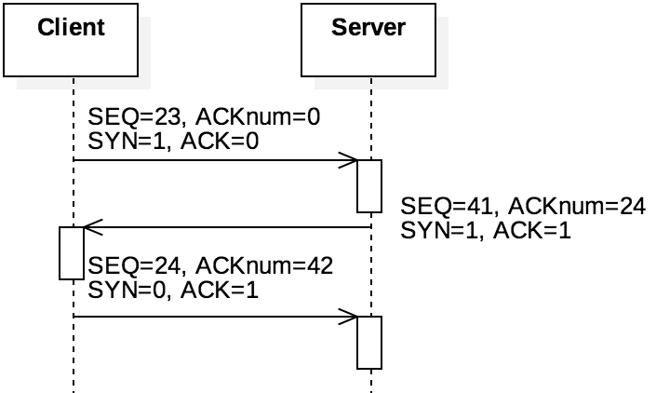
TCP handshake
When a TCP connection is being established by a client calling connect(), three segments are sent:
SYN (from the client)
SYN-ACK (from the server)
ACK (from the client)
These segments are called the three-way handshake
They are normal segments except that they have no data
The SYN bit is set on the SYN and SYN-ACK segments, and the ACK bit is set on the ACK segment
ACK is set on any segment intended to show that an earlier segment is being acknowledged

Slide 73
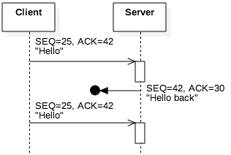
Packet loss
Using SEQ and ACK numbers with the checksum allows for error detection
It's hard to be sure what went wrong, but some conclusions can be drawn:
Incorrect ACK: If the ACK is too small, the sender of the ACK missed one or more messages
Incorrect SEQ: If the SEQ is larger than expected, the receiver of the SEQ missed one or more messages
Incorrect checksum: The segment is corrupted or part is missing
In all three cases, sending the last segment based on acknowledged data is a request for the other side to resend

Slide 74
Timeouts
To make robust guarantees about message delivery, TCP also keeps track of the time it takes for segments to make a trip
If a segment is missing for long enough, TCP can request it again
How long should it wait?
Because the Internet is a large and heterogeneous place, it wouldn't make sense to wait for any particular fixed time
Instead, the retransmission timeout (RTO) is computed based on previous transmission times and how much they fluctuate

Slide 75
Network Security

Slide 76
CIA
Confidentiality
Integrity
Availability
Network security is built on principles from general computer security:
Confidentiality
Integrity
Availability

Slide 77
Confidentiality
You don't want other people to be able to read your stuff
Some of your stuff, anyway
Cryptography, the art of encoding information so that it is only readable by those knowing a secret (key or password), is a principle tool used here
Confidentiality is also called secrecy or privacy

Slide 78
Integrity
You don't want people to change your stuff
You want to know:
That your important data cannot be easily changed
That outside data you consider trustworthy cannot be easily changed either
There are many different ways that data can be messed up, and every application has different priorities

Slide 79
Availability
You want to be able to use your stuff
Many attacks are based on denial of service, simply stopping a system from functioning correctly
A SYN flood where attackers try constantly to create TCP connections from spoofed IP addresses is a classic DoS attack
Availability can mean any of the following:
The service is present in usable form
There is enough capacity for authorized users
The service is making reasonable progress
The service completes in an acceptable period of time

Slide 80
Cryptography
"Secret writing"
The art of encoding a message so that its meaning is hidden
Cryptanalysis is breaking those codes
Cryptography is a powerful tool for confidentiality because modern encryption methods make it almost impossible to read an encrypted message
Cryptographic hash functions provide a tool for integrity because they can make it obvious when a message has been changed

Slide 81
Cryptography and availability
Although cryptography provides tools for confidentiality and integrity, there's no clear cryptographic tool for availability
In fact, cryptography often makes availability worse because encryption puts more strain on a system
Making it more susceptible to various DoS attacks
There's always tension between confidentiality, integrity, and availability
Increasing confidentiality and integrity usually decreases availability

Slide 82
Encryption and decryption
Encryption is the process of taking a message and encoding it
Decryption is the process of decoding the code back into a message
A plaintext is a message before encryption
A ciphertext is the message in encrypted form
A key is an extra piece of information used in the encryption process

Slide 83
Symmetric key cryptography
Symmetric encryption is what you probably think of as encryption
Two parties have a key which they use for both encrypting and decrypting messages
The key is also known as a shared secret
We have excellent symmetric encryption algorithms, of which AES is the most used
But how do we distribute keys between parties who want to communicate secretly?

Slide 84
AES
Advanced Encryption Standard
Symmetric block cipher designed to replace DES
Block size of 128-bits
Key sizes of 128, 192, and 256 bits
Like the older (and deprecated) DES, has a number of rounds (10, 12, or 14 depending on key size)
Originally called Rijndael, after its Belgian inventors
Competed with 14 other algorithms over a 5 year period before being selected by NIST
No known attacks exist against good implementations of AES
It should take more than a billion billion years to break an AES encryption
Even quantum computers shouldn't change that much

Slide 85
Public key cryptography
Sometimes, we need something different
We want a public key that anyone can use to encrypt a message to Alice
Alice has a private key that can decrypt such a message
The public key can only encrypt messages; it cannot be used to decrypt messages
Public key cryptography is enormously useful, since companies can publish their public key far and wide
Anyone who wants to send them a secret message can do so
No secret needs to be shared ahead of time

Slide 86
Symmetric vs. public key
Symmetric Key Cryptography
Key K
Plaintext M
Encryption
Ciphertext C
Decryption
Plaintext M
Public Key Cryptography
Encryption Key K_{E}
Decryption Key K_{D}
Plaintext M
Encryption
Ciphertext C
Decryption
Plaintext M

Slide 87
RSA Algorithm
RSA is the most commonly used public key cryptosystem
Named for Rivest, Shamir, and Adleman
Take a plaintext M converted to an integer
Create an ciphertext C as follows:
C = Me mod n
Decrypt C back into M as follows:
M = C^{d} mod n = (Me)^{d} mod n = M^{ed} mod n

Slide 88
Why it's safe
Crazy number theory
For RSA, the modulus n = p·q where p and q are two large (hundreds of digits) primes
It's easy to compute d, the decryption exponent, if you know p and q
No one knows an efficient way to factor a large composite number
However, quantum computers could make RSA much less safe

Slide 89
Catch-22
Your computer needs to be able read the password file to check passwords
But, even an administrator shouldn't be able to read everyone's passwords
Hash functions to the rescue!

Slide 90
Definition
A cryptographic (or one-way) hash function (also called a cryptographic checksum) takes a variable sized message M and produces a fixed-size hash code H(M)
Not the same as hash functions from data structures
The hash code produced is also called a digest
It can be used to provide authentication of both the integrity and the sender of a message
It allows us to store some information about a message that an attacker cannot use to recover the message

Slide 91
Collisions
When two messages hash to the same value, this is called a collision
Because of the pigeonhole principle, collisions are unavoidable
The key feature we want from our hash functions is that collisions are difficult to predict

Slide 92
Crucial properties
Preimage Resistance
Given a digest, should be hard to find a message that would produce it
Collision Resistance
Should be hard to find any two messages that hash to the same digest (collision)
One-way property
Second Preimage Resistance
Given a message m, it should be hard to find a different message that has the same digest

Slide 93
Additional properties
Avalanching
A small change in input should correspond to a large change in output
Speed
It should be fast to compute a digest in software and hardware
Uniformity
Output should be a fixed length
Applicability
Hash function should work on a block of data of any size
No longer than retrieval from secondary storage

Slide 94
Password dilemma resolved
Instead of storing the actual passwords, Windows and Unix machines store the hash of the passwords
When someone logs on, the operating system hashes the password and compares it to the stored version
No one gets to see your original password!
Hash functions are also used for digital signatures

Slide 95
SHA family
Secure Hash Algorithm
Created by NIST
SHA-0 was published in 1993, but it was replaced in 1995 by SHA-1
The difference between the two is only a single bitwise rotation, but the NSA said it was important
SHA-1 security
Digest size: 160 bits
Considered unsafe
Theoretical attacks can run in 2⁶³ SHA-1 evaluations
SHA-2 is a successor family of hash functions
224, 256, 384, 512 bit digests
Now the preferred hashing function
Designed by the NSA

Slide 96
SHA-3
SHA-3 (Keccak) uses a completely different form of hashing than SHA-0, SHA-1, and SHA-2
Although the attacks on SHA-1 are expensive and there are no real attacks on SHA-2, the attacks on SHA-0 made people nervous about hash functions following the same design
SHA-3 also allows for variable size digests, for added security
224, 256, 384, and 512 are standard
Either SHA-2 or SHA-3 is considered secure (for now)

Slide 97
Transport-Layer Security
Transport-Layer Security (TLS) adds end-to-end security to TCP
Secure versions of protocols often add an "s" to their names: HTTPS, SFTP, and IMAPS
These protocols use TLS
With TLS, the TCP data is encrypted
However, the TCP headers are not encrypted
If they were, the OS wouldn't know which port to deliver them to
Because network traffic needs to know where to go, it's usually possible to do traffic analysis, even when the data is encrypted

Slide 98
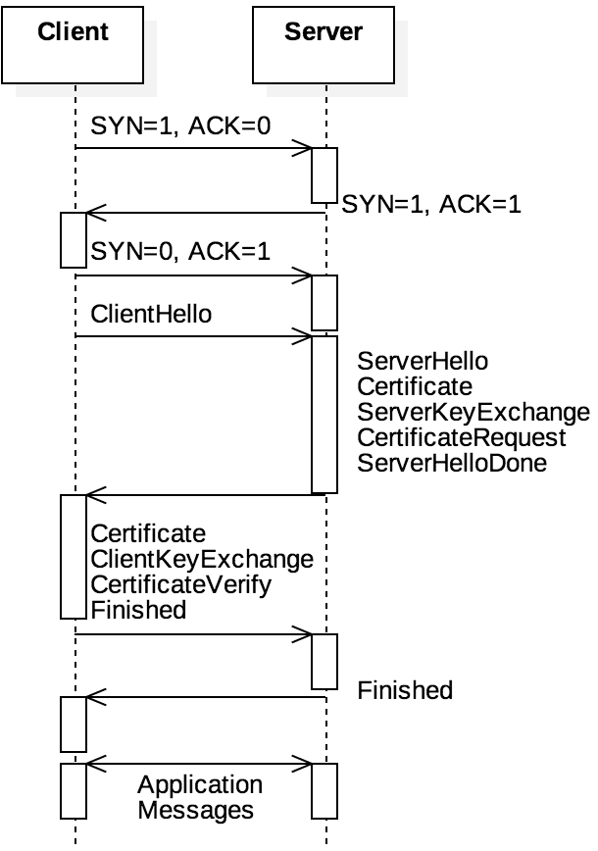
TLS handshake
With TLS, the connection first performs a TCP three-way handshake
Then, the client and the server perform a TLS handshake that uses public key cryptography to agree on a session key
The session key is used to communicate securely using symmetric key encryption (probably AES) during the TCP session

Slide 99
Confidentiality and integrity
Because the data in the TCP segments is encrypted with AES, the information's confidentiality is maintained
To protect integrity, a message authentication code (MAC) of the TCP headers is attached as an optional TCP field
The MAC is a cryptographic hash digest, probably using SHA-2
These are the broad strokes, but there are many details
Details change with each version of TLS
We're up to TLS 1.3 now

Slide 100
Internet Layer

Slide 101
Internet layer
TCP and UDP provide a framework for end-to-end communication between processes
But they ignore the fact that different hosts are communicating
The Internet layer provides a system for getting messages from host to host
The data plane gives the structure of the network, using Internet Protocol (IP) addresses
The control plane controls how messages are routed through the network

Slide 102
IP addresses and subnets
IPv4 addresses only allow for about 4 billion addresses
One approach for dealing with this limitation is subnets
Private subnets have IP addresses that can't be reached from outside
Subnets sometimes use the notation of an IP address followed by /n where /n is some number of bits like /16 or /24, meaning that addresses inside the subnet must match the first 16 or 24 bits
Example: 192.168.0.0/16 means everything on the subnet must start with 192.168
The matching bits can also be specified as a subnet mask: 255.255.0.0 is the one matching the first 16 bits

Slide 103
Special subnets
Three ranges of IP addresses are reserved in IPv4 for private subnets:
192.168.0.0/16 (2¹⁶ = 65,536 possible devices)
172.16.0.0/12 (2²⁰ = 1,048,576 possible devices)
10.0.0.0/8 (2²⁴ = 16,777,216 possible devices)
The first range is probably familiar to you because it's used for most home networks
IPv6 has its own range, fd00::/8, that allows for up to 2⁶⁴ devices

Slide 104
NAT
So that different subnets can communicate, a router connects the private subnet to the Internet
The router has a private IP address, used to communicate with the subnet, and a public IP address, used to communicate with the rest of the world
Routers do network address translation (NAT), a kind of IP masquerading
The outside world only sees the router's IP
When the router gets a message, it sends it to the appropriate device in the private subnet
The router observes traffic and changes port numbers on incoming and outgoing packets so that multiple devices behind the router can communicate with a single server

Slide 105
Visualization of subnets
Alice's Home
Bob's Home
192.168.1.3
192.168.1.5
192.168.1.7
192.168.1.2
192.168.1.1
192.168.1.0
Internet
75.3.28.14
75.3.28.27
ISP

Slide 106
IPv4 packet format
version distinguishes between IPv4 and IPv6
protocol is TCP or UDP
checksum is just for the header and does no checking for the payload
TTL gives the number of times the packet can be forwarded (keeps packets from hopping around forever)
Like UDP, IP makes no guarantees about reliability
The purple options fields are variable length
0-3 | 4-7 | 8-11 | 12-15 | 16-19 | 20-23 | 24-27 | 28-31
version | length | type of service |  | total length
identification |  |  |  | flags | fragment offset
TTL |  | protocol |  | checksum
source address
destination address
options
payload (transport-layer segment)

Slide 107
Network routing protocols
The Internet is a network of networks
Each independent network controlled by a single entity is called an autonomous system (AS)
Each AS connects to other ASes at gateway routers
BGP is a protocol that describes how these routers communicate to each other the paths through them to other networks
Within an AS, OSPF, RIP, and other protocols determine the fastest route through the network
OSPF uses Dijkstra's shortest path algorithm based on time delays, broadcasting information to other routers
Alternatively, when a router using RIP discovers a new shortest path, it forwards the information only to its neighbors

Slide 108
Link Layer

Slide 109
Link layer
The Internet layer focuses on routing packets through networks
The link layer focuses on forwarding packets from point to point
This forwarding all happens within a single kind of technology
Things can go wrong at this fundamental level of networking:
Processing delay because checksums and other information have to be computed
Queuing delay because other packets are waiting to be sent
Transmission delay because converting to the physical layer takes work
Propagation delay because the physical layer can't send data instantly
All these delays can add up

Slide 110
Ethernet
Ethernet is one of the best known examples of link level protocols
Ethernet is a collection of standards for communicating over copper or fiber optics
Like higher level protocols, Ethernet also wraps its data with a header (and a footer too)
Typically, link layer packets are called frames
For historical reasons, Ethernet frames are described in octets (always 8 bits) rather than bytes (which used to be variable in size)

Slide 111
Ticket Out the Door

Slide 112
Upcoming

Slide 113
Next time…
Review after Exam 2

Slide 114
Reminders
Finish Assignment 8
Due Friday before midnight!
No office hours today from 3-4 p.m. because of Honors Convocation

